Slide 1
WELCOME
Class: B.Com – Part-1
Subject: Financial Accounting
TOPIC: Branch Accounts – Part - 1
Prepared By
Dr. SHAHID IQBAL
Guest Faculty
Marwari College, Darbhanga,
Mobile No. and Whatsup No. : 7004160257
Email ID: shahidlnmu@gmail.com

Slide 2
Meaning of Branch and Branch Accounts:
A branch can be described as any establishment carrying on either the same or substantially the same activity as that carried on by head office of the company. It must also be noted that the concept of a branch means existence of a head office; for there can be no branch without a head office – the principal place of business.
The term ‘Branch Accounts’ refer to record of transaction of branches, whether relating to deal with Head Office or with outsiders or deal between different branches in the books of Head office. In order to exercise greater control over the branches, it is necessary to ascertain profit or loss made by such branches separately. For this purpose, a proper accounting system is to be adopted for recording business transactions between Head Office and Branches.

Slide 3
From the accounting point Of view, branches can be broadly classified into two categories for the purpose of recording transactions in the books of accounts i.e.

Slide 4
Home Branches
A. Dependent Branches : Dependent branches are those branches which are both keeping their own separate set of books of accounts. The relation between head office and branch is just like agency, therefore, these are also known as agency branches. The following are the salient features of such a branch :
(i) These branches generally depend upon the head office for supply of goods. However, the branch may be allowed to make purchases from the local parties.
(ii) All expenses of the branch are directly paid by the head office.
(iii) In order to meet the petty expenses of the branch, e.g., conveyance expenses, entertainment expenses etc., may be provided with the petty cash from the head office.
(iv) Normally branches receiving goods from head office selling for cash only but also selling on credit if it is authorised by the head office.
(v) Cash received from branch from its debtors or on account of cash sales is daily remitted to head office or deposited into a bank account opened in the name of the head office.
(vi) Such branches maintain certain memorandum records only such as cash book, debtors account and stock registers.

Slide 5
Accounting procedure :
In case of a dependent branch, the head office may keep accounts of the branch according to the following methods :
1. Debtors or Direct Method
2. Final Accounts Method
3. Stock and Debtors Method
1. Debtors or Direct Method
Under this method, head office opens one account for one branch. This account is called Branch Account. The object of this account is to disclose branch profit or loss. This branch account is a nominal account. The head office maintains this account in its books. Normally this method is followed in case of branches of small size. On the basis of nature and size of branch, the dependent branch can be divided into three parts for the purpose of recording transactions in the books :

Slide 6
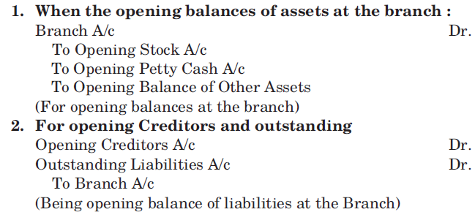
Branch receiving goods from head office at cost price and making cash sales only :
These branches receive goods from head office at cost price, sell for cash only and remit the cash collected to the head office. All expenses of the branch are directly paid by the head office. These branches do not make its own set of books. To find out the profit or loss of these branches, the following accounting entries are passed in the books of the head office :

Slide 7
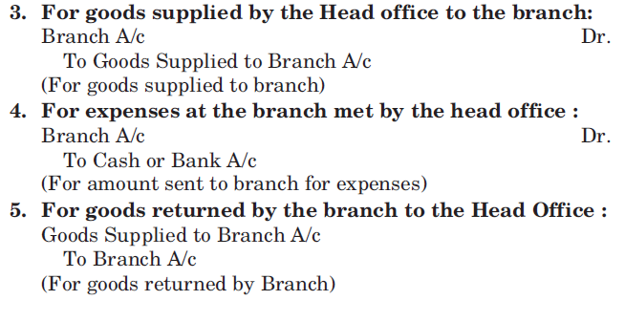
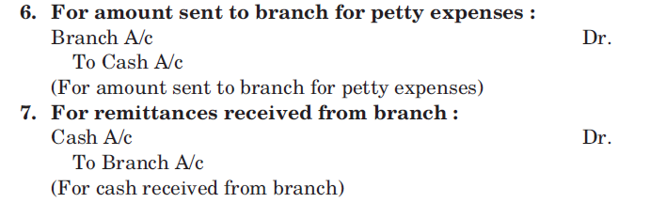

Slide 8
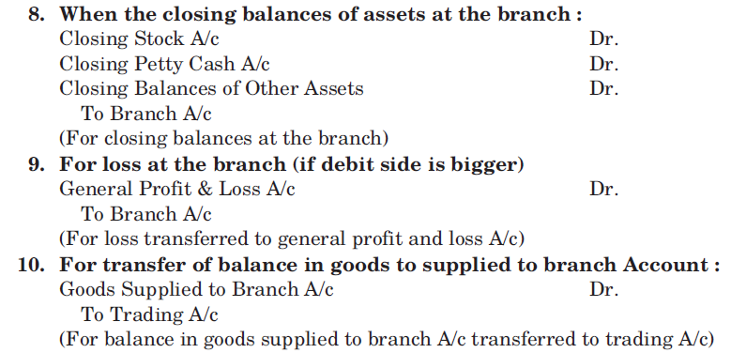

Slide 9
Thank You

